Slide 1



AI HACKATHON
Organized By Acharya Institutes

Slide 2

Table of contents
01
02
03
the project
requirements
project goals
Medical chatbot
Medical chatbot
Awareness regarding medicine usage
04
05
06
Novelty
COMPETITION
our team
NLP and Regional Language Inclusion
About Leading medical chatbot companies
About our members

Slide 3
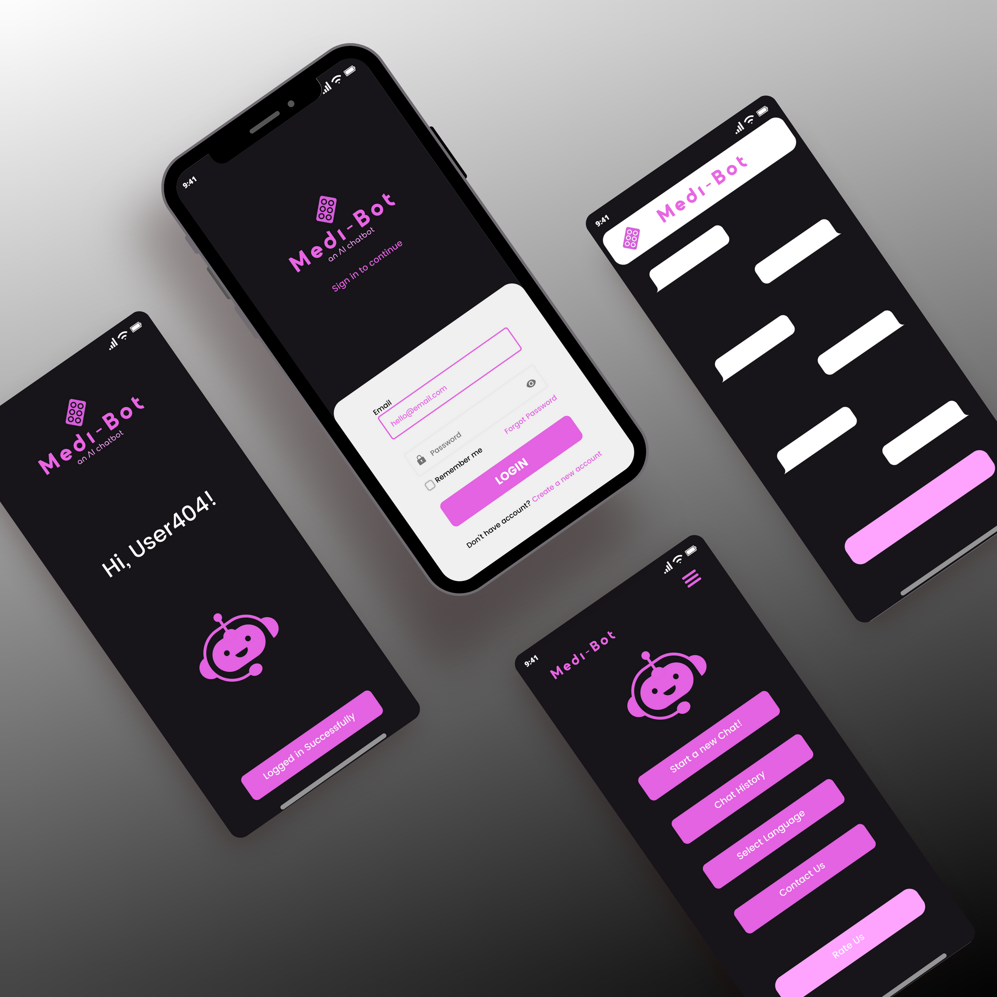

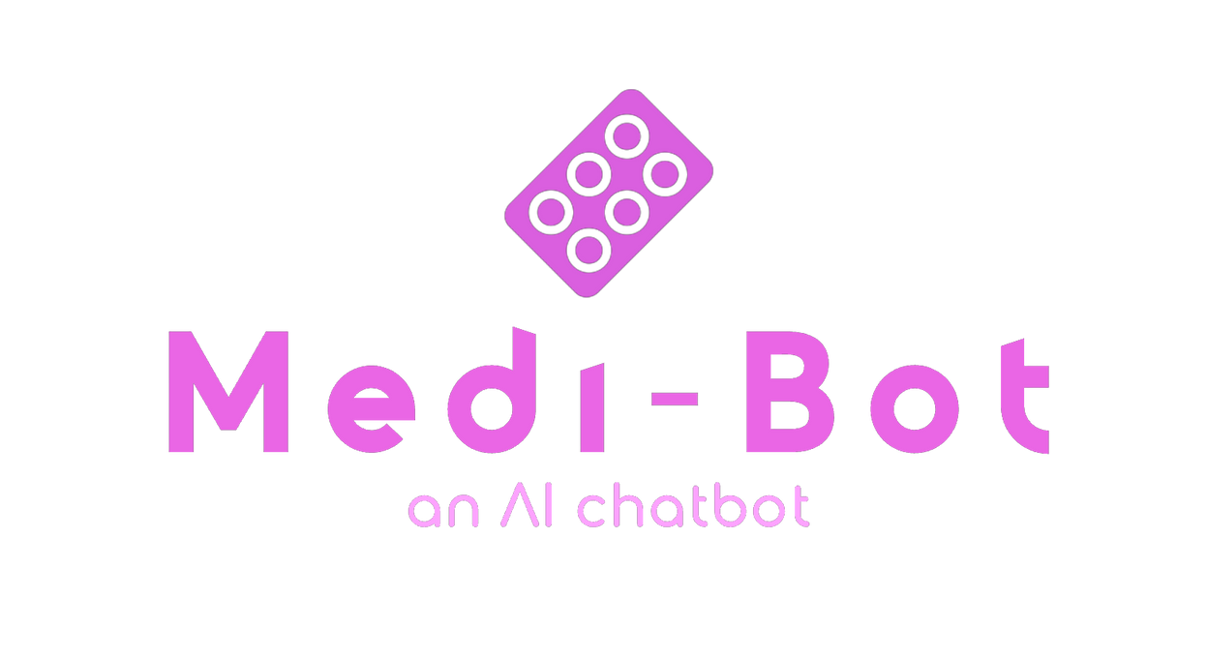
01
#BOT-lers

Slide 4
About the project ( team MEMBERS)
Dr. Ajith Padyana (Mentor) :
HOD, Dept of CSE, AIT ~ +91 9731015499
ANIKETH HEBBAR :
BE in AIML (3rd year) ~ +91 9019772846
https://github.com/anikethhebbar
KEVIN RONEY:
B.Sc in NURSING (1st year) ~ +91 9567098529
KAVANA M:
MCA (1st year) ~ +91 8073147544

Slide 5

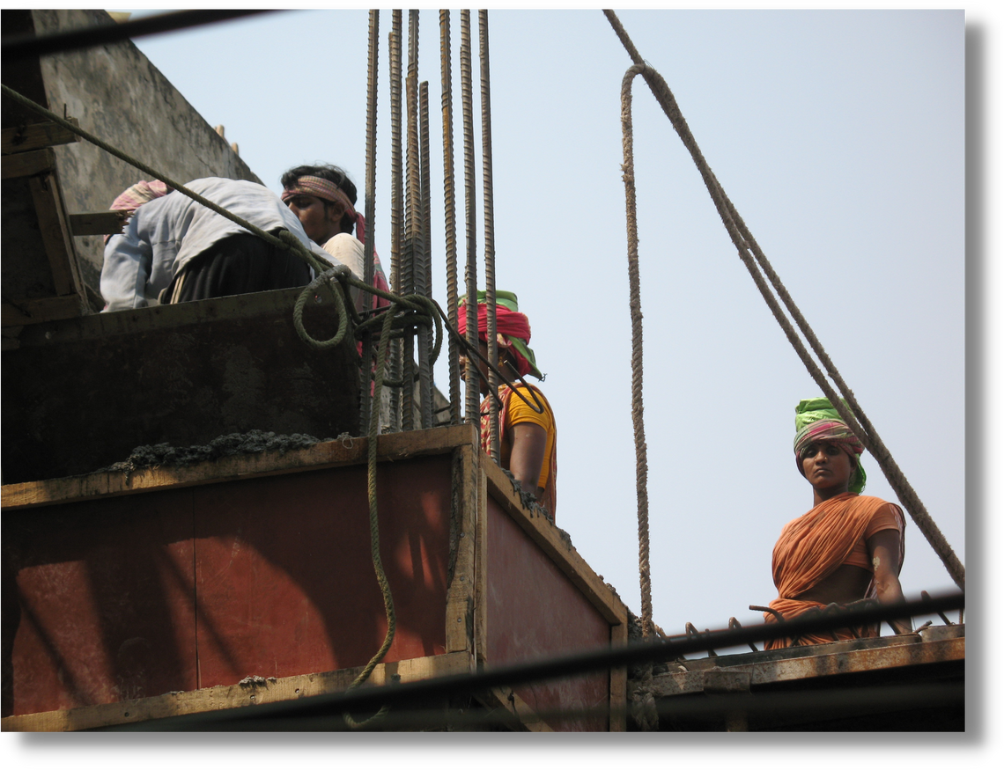
Now
MANY PEOPLE DO NOT KNOW THE POTENTIAL SIDE EFFECTS OF DRUGS
THEY CONSUME IT CONTINUOUSLY WITHOUT THE PRESCRIPTION OF A DOCTOR.
WHICH LEADS TO SEVERE HEALTH PROBLEMS.
IT IS MOSTLY SEEN IN COMMON PEOPLE LIKE CONSTRUCTION WORKERS etc.

Slide 6

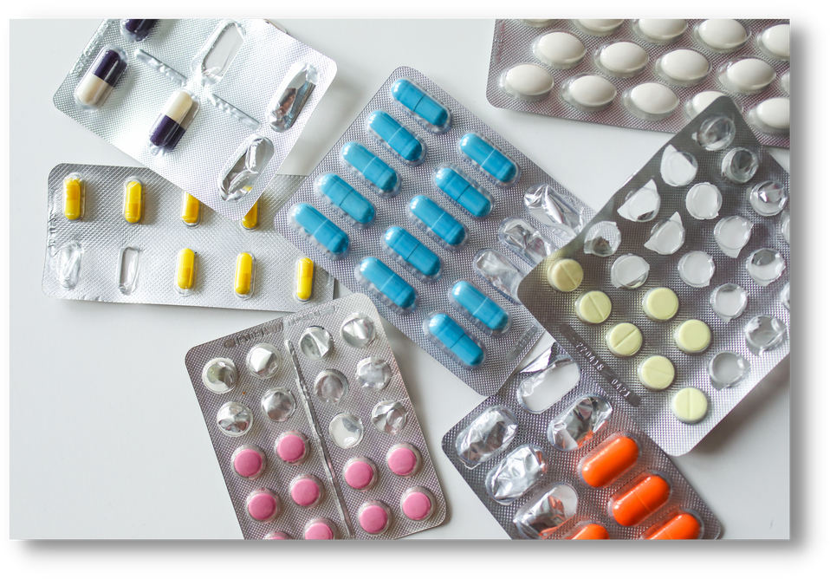
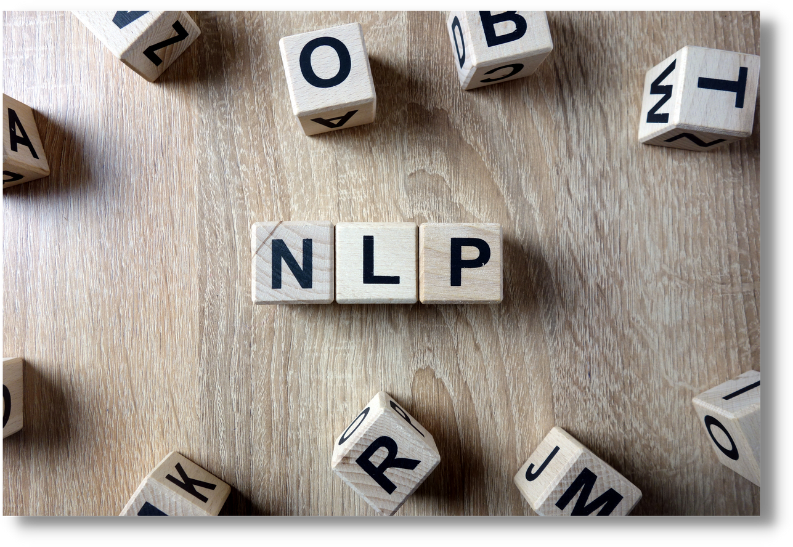
Future
WE CREATE A CHATBOT TO INFORM USERS ABOUT THE SIDE EFFECTS OF SPECIFIC MEDICINES
WE ARE USING NLP AND UPDATE ALL MEDICINES WITH ITS CONTRAINDICATIONS

Slide 7

02
Major requirements
COMPLEX DIALOGUES SIMPLIFICATION
FLEXIBLE DATA COLLECTION
EASY HANDLING
FAST ONBOARDING
ONGOING OPTIMIZATION
ANALYTIC AND REPORTING
NLP TRAINING

Slide 8
03
Project goals
Updating this chatbot to leading national health apps like "Esanjeevani" and "Umang" .
This will enable common people to easily track their continuous drug use.
Inform common people about the potential health risks of continuous drug use.
Even for mild pain or illness, as pharmacy staff may prioritize profit and commission over their health.

Slide 9
NOVELTY ADDED TO OUR PROJECT
04
NLP(Natural language processing)
A technology that can interact people with their common human language.
We have used NLTK for training the model.
Suggestions in Regional Language
We are providing users the ability to raise their queries in regional languages.
This feature will be particularly useful in these areas, where access to resources can be limited.

Slide 10
BUDGET PLANNING
Starting the project will require a budget of around 4-6 lakh INR.
This will be necessary to get the project off the ground.
This budget is crucial for launching the project successfully.

Slide 11

05
Some of our competitors
ADA check your health -ADA HEALTH
FLORENCE - AI powered Digital health worker

Slide 12

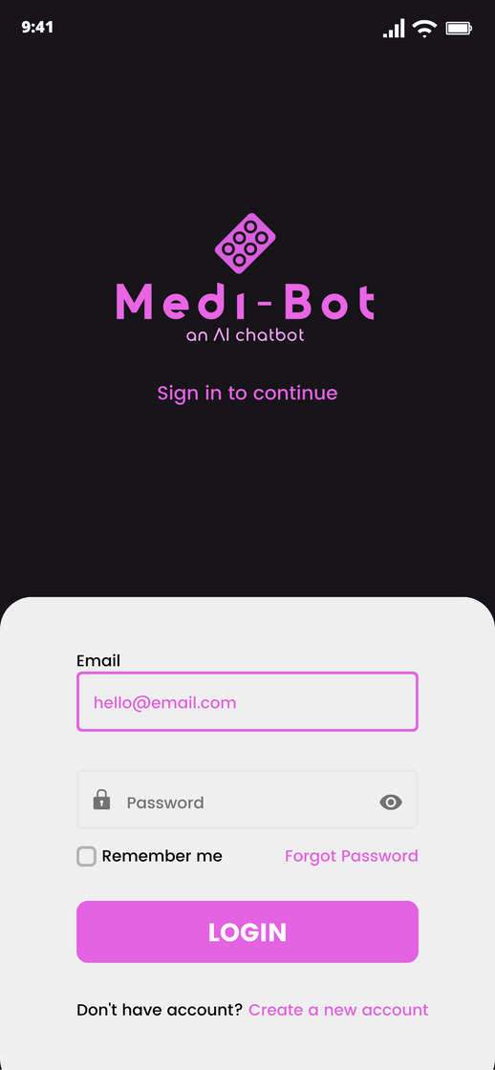
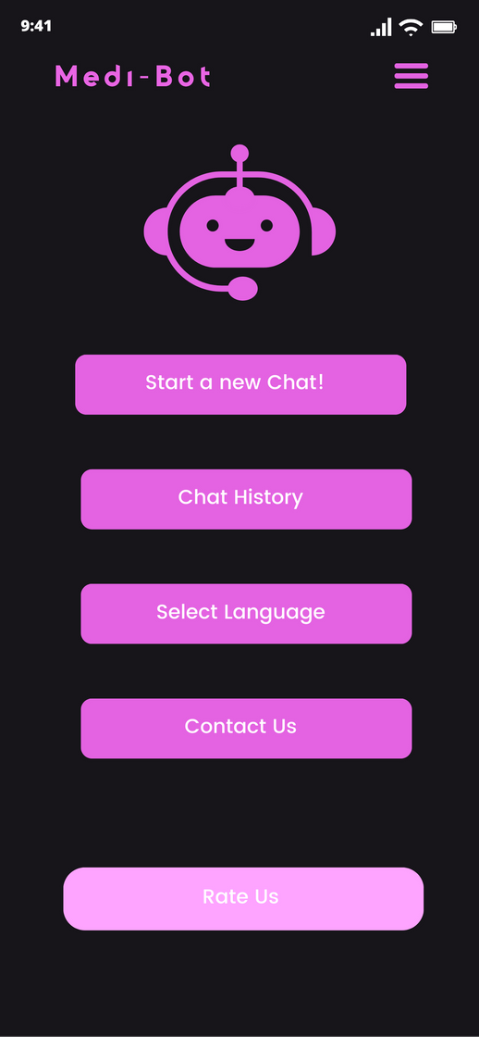
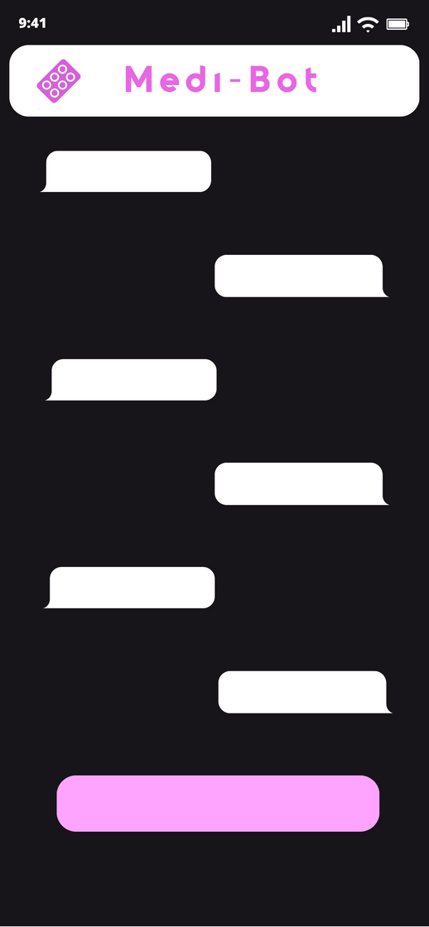
DEMO-UI & UX

Slide 13
06
Our team & strength
Dr. Ajith Padyana (Mentor) :
Head of the Department. Dept. of CSE, Acharya IT
Bengaluru.
ANIKETH HEBBAR:
Technical Part, Coding and Team Lead
KEVIN RONEY:
Awareness and Medical Research.
KAVANA M:
Presentation, Ideation and Team Co-ordination

Slide 14
Thank YOU

